Slide 1
What is Cloud Computing ?

Slide 2
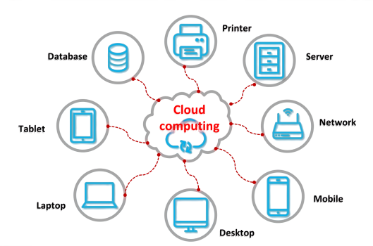
Behind the Cloud

Slide 3
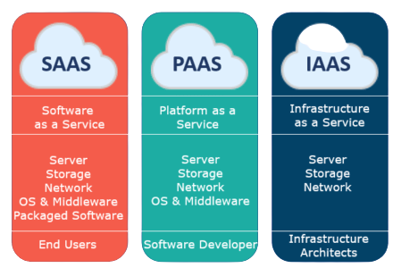
Cloud Computing Models

Slide 4
Fundamental Difference between
Different Cloud Platforms

Slide 5
Linux Flavors
RedHat
Suse
Fedora
Debian
Ubuntu
Knoppix
Slackware
Lycoris
Linspire (Lindows)
Windows Versions
Windows 98
Windows Me
Windows 2000
Windows 2003
Windows XP
Windows vista
WINDOW 7
WINDOW 8
Windows 10

Slide 6
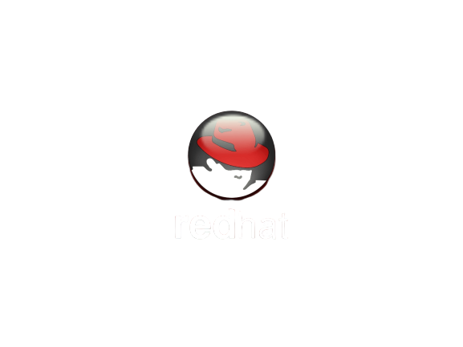
RedHat Technologies is the best Career Path for Your Future

Slide 7
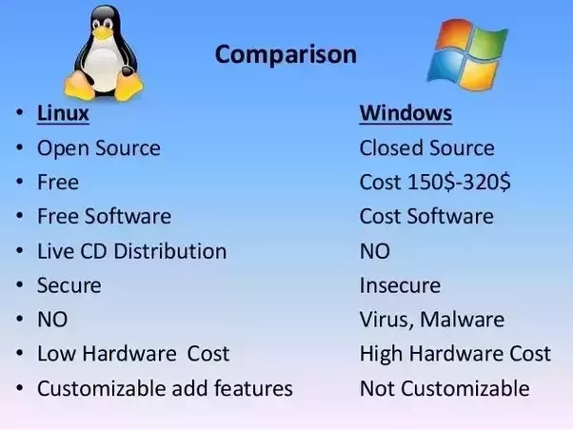
Why RedHat / Linux is More Popular and Used in IT Infrastructure

Slide 8
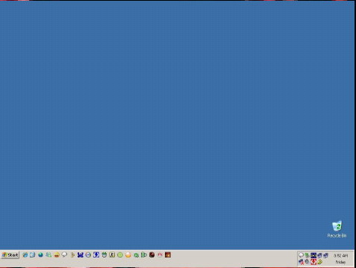
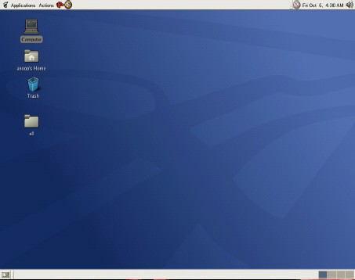
Graphical User Interface
(GUI)

Slide 9
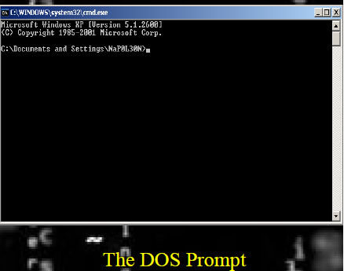
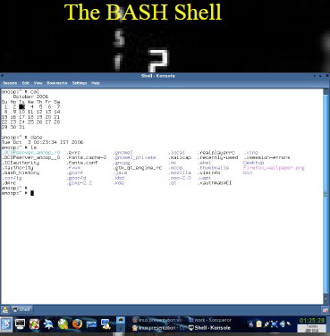
Text Mode Interface

Slide 10
Why Linux is More Secure ?
- More Secure (ex. - No Auto run .exe - program) - Command Base(Only Known people will handle OS) - It’s file name case-sensitive. - Linux is widely used in hacking purpose based systems.
Login - At a time 7 users can login
- Not Secure (ex. - Auto run of .exe program) - GUI Base (Common people can use) - While it’s file name is case-insensitive. - While windows does not provide much efficiency in hacking.
Login - At a time only single user can login

Slide 11
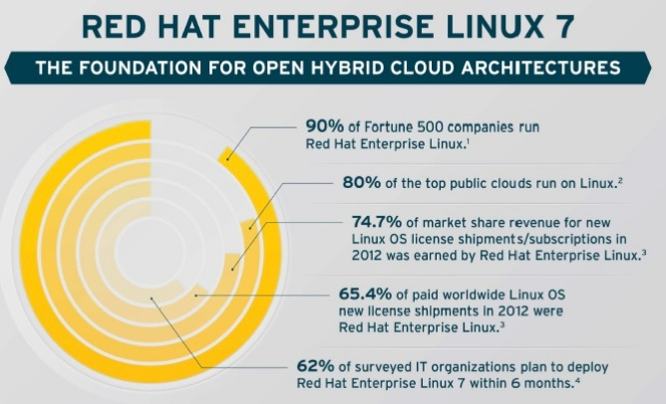
Growth

Slide 12

Want to become System Administrator ?

Slide 13
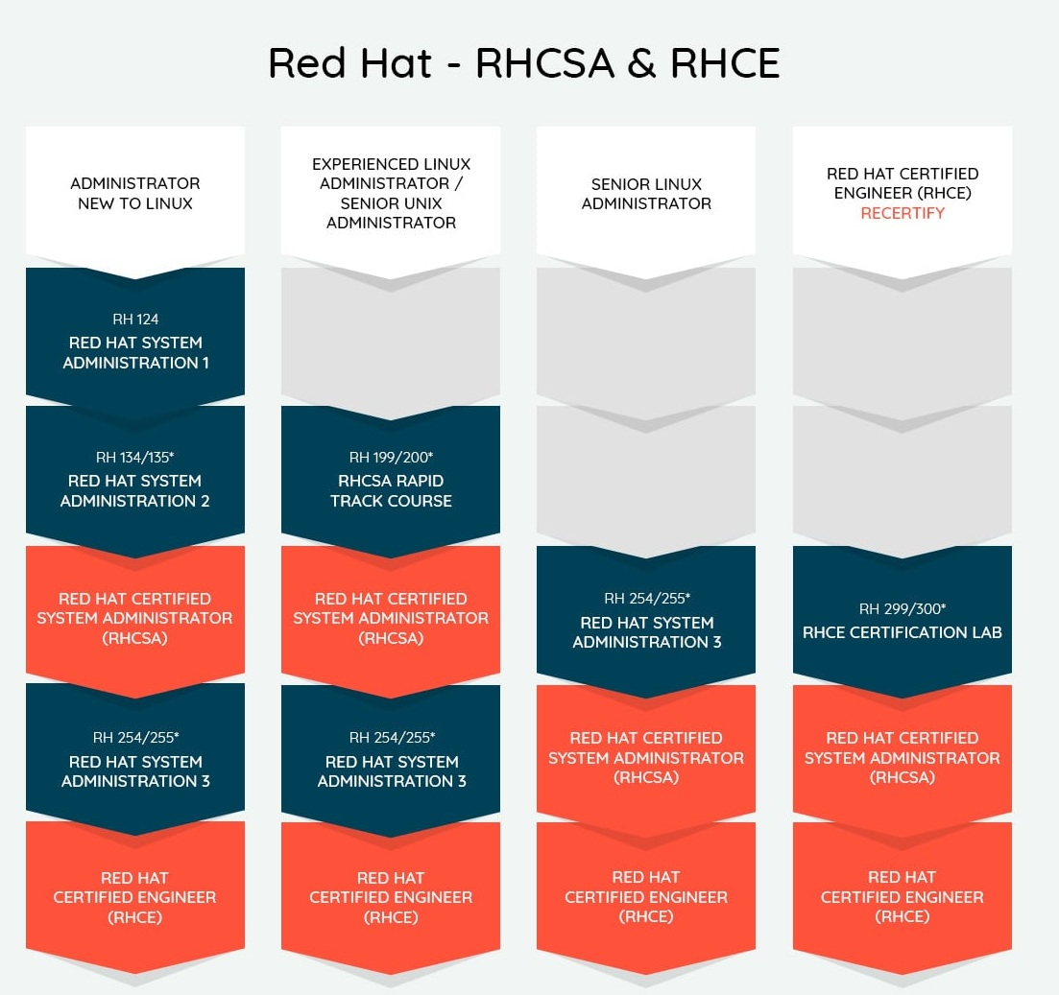

Slide 14
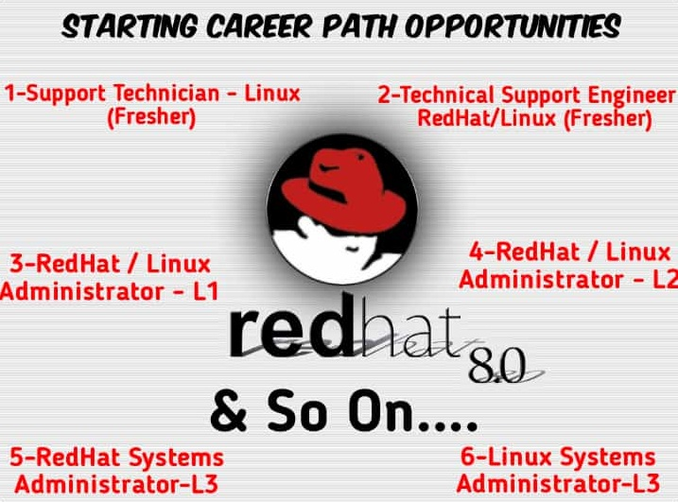

Slide 15
Syllabus Covered in RHCSA & RHCE(7 & 8)
RHCSA RH124 & RH134
RHCE RH254 & RH294

Slide 16
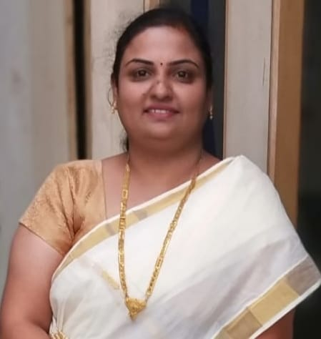
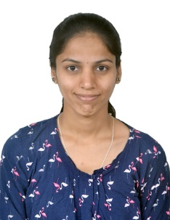
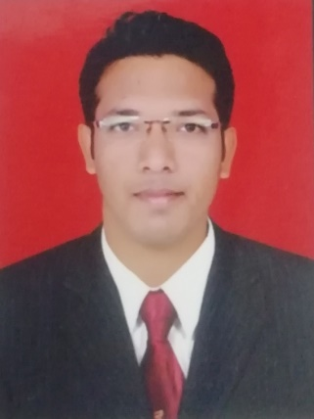
NetLeap Founder Members
Mrs. Mrunal Dahale
Director
(Forensic Consultant, Network, Windows Expert)
Miss. Priyanka Gaikwad
Director
(RedHat & Linux Technologies Expert)
Mr. Dinesh Chauadhari
Director
(Network & Cloud Expert)

Slide 17

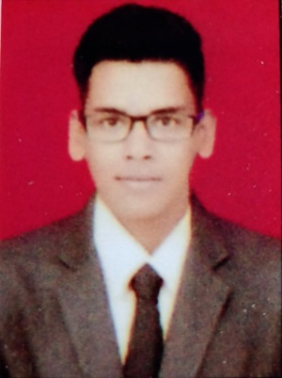
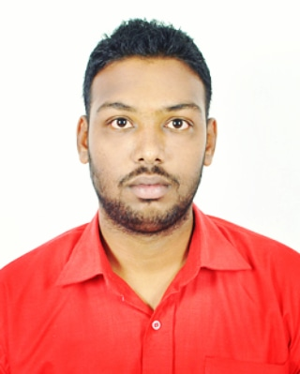
NetLeap Faculty Members
Miss. Swarada Kabnurkar Advocate
(B.S.L.LL.B & Diploma in Cyber Law)
Mr. Aman Gupta
(Ethical Hacking & Forensic Expert)
Mr. Gaurav Shirsath
(Cloud Developer, Native & Object Oriented Language Expert)

Slide 18


NetLeap Faculty Members
Mr. Akash Patil
(Network & Cisco Technologies Expert)
NetLeap IT Training & Solutions
9307338125 / 8329349481 Address – Flat No 03, Sitagufa Society, Near Vidya Vikas Circle, Gangapur Road, Nashik.

